Slide 1
User interfaces
T-Level

Slide 2
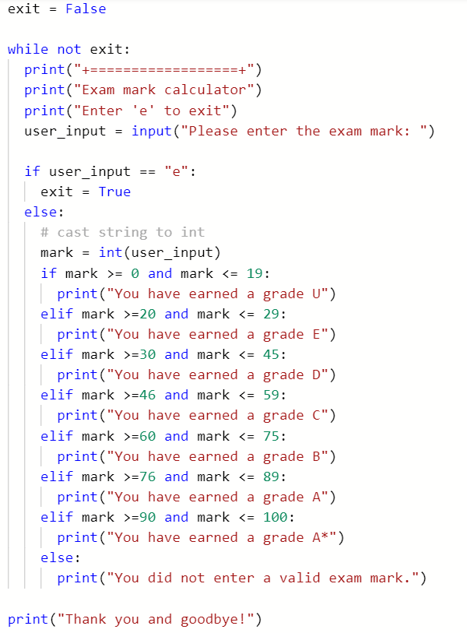
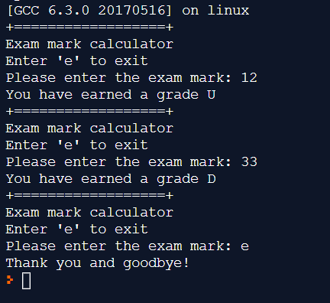
https://repl.it/@JohnGlazebrook/while-loops-student-grades

Slide 3
https://repl.it/@JohnGlazebrook/menu-example
https://repl.it/@JohnGlazebrook/menu-example-2
http://www.teachingcomputing.com/learn.php?a=06_Mini_Projects_visit_www_teachyourselfpython_com&t=01_Form_Tutor_System_NEA_OCR_Task1&s=02_MainMenu_Define_Functions

Slide 4
Python lists

Slide 5
Today
Investigate lists in Python
Uses
Creation

Slide 6
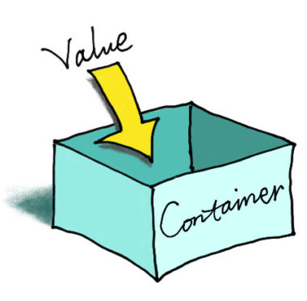
Today - lists
A list in Python is a type of sequence
Previously we saw how when we declare a variable, it can store one value
A list is a variable that can store more than one value.

Slide 7
Used when you don’t know how many things you need to store
score1, score2, score3, score4 …. ?

Slide 8
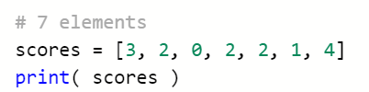

Used when you don’t know how many things you need to store
score1, score2, score3, score4 …. ?

Slide 9
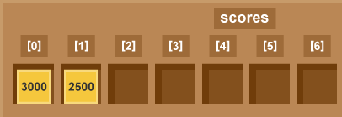
Index
3
2
0
2
2
1
4
Value

Slide 10
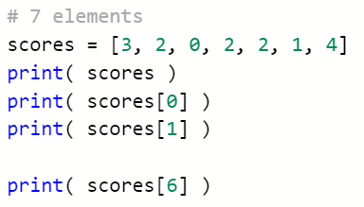
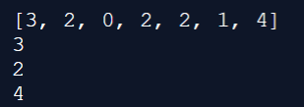

Slide 11


Slide 12
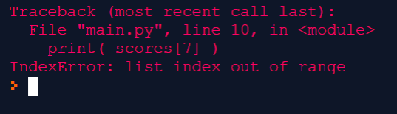

Slide 13
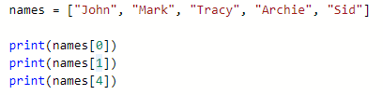

lists
Each value is stored in an “element” – the above list has 5 elements
Each element has an index
Lists use 0-based indexes – the first element has an index of 0.

Slide 14
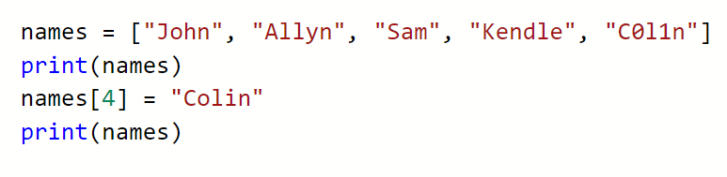
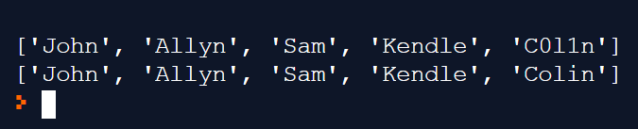
Set an element

Slide 15

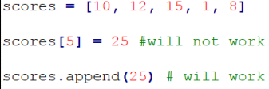
Appending to a List
A list is a fixed size, you cannot simply add a new element by:
You must use the append method:

Slide 16

Joining Lists
It is possible to join one list to another
This is known as concatenation:
numList1 now is [1, 2, 3, 4, 5, 6, 7, 8]

Slide 17
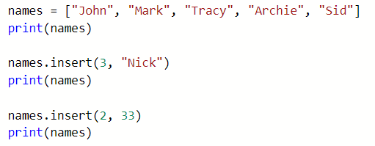

insert
Insert an integer

Slide 18
Terminology
Most programming languages have an array variable
Arrays do not exist in Python…
…lists do the same job as arrays

Slide 19


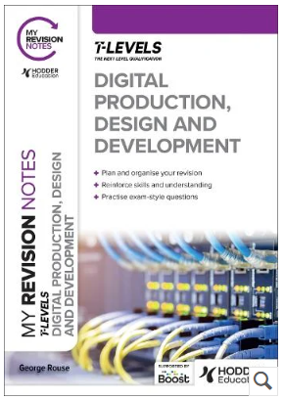
You need the book!
Around £35
Buy it!

Slide 20
TASKS
Make sure you understand lists
Research and write code for:
Range of indexes
Does an item exist in the list?
List length
Append an item
Del
Join two lists
Think:
Menu
Functions
CRUD

